Slide 1
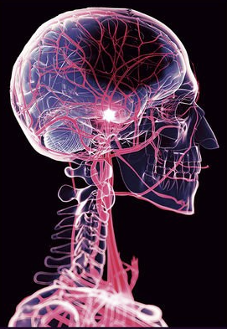
What is a Stroke?
Disease Detection and Prediction
1
GROUP 4:
Yi Ren
Beatrice Nicole Tanlapco
Victor Ehizonomen

Slide 2
Introduction
2
Motivation:
Stroke is the 2nd leading cause of death globally.
Although stroke is irreversible, early recognition of the warning signs at different stages of stroke can minimize the probability of stroke. Many people with stroke lead a full, enjoyable life when the condition is managed.
Research goal:
The goal of this research is to base on age, hypertension, heart disease, average glucose level, bmi values and smoking status. By using different machine learning methods to predict whether a patient is likely to have a stroke or not.
To determine what variables are important and influential in detecting the patient.

Slide 3

Data Exploration
3
Dataset Source: From the website-- Kaggle. The dataset is Stroke Prediction Dataset.
(link: https://www.kaggle.com/datasets/fedesoriano/stroke-prediction-dataset)
id | Unique patient identifier
gender | “Male”, “Female”, or “Other”
age | Age of patient
hypertension | 0 if patient doesn’t have hypertension, 1 if patient has hypertension
heart_disease | 0 if patient doesn’t have any heart disease, 1 if patient has a heart disease
ever_married | “No” or “Yes”
work_type | “children”, “Govt_job”, “Never_worked”, “Private”, or “Self-employed
residence_type | “Rural” or “Urban”
avg_glucose_level | Average glucose level in blood
bmi | body mass index
smoking_status | "formerly smoked", "never smoked", "smokes" or "Unknown"*
stroke | 0 if patient never had a stroke, 1 if patient has had a stroke

Slide 4
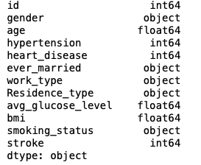
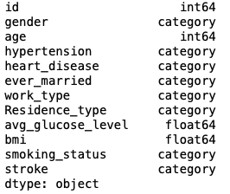
Data Analysis Process a. Data Pre-processing and cleaning
4
Changing data types
Figure 1 : Before changing data types Figure 2 : After changing data types

Slide 5
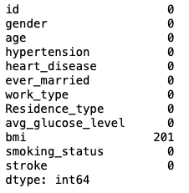
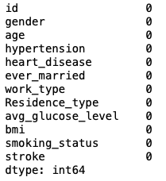
Data Analysis Process
5
Imputing the missing values
Figure 3 : Before imputing the missing values Figure 4 : After imputing the missing values

Slide 6
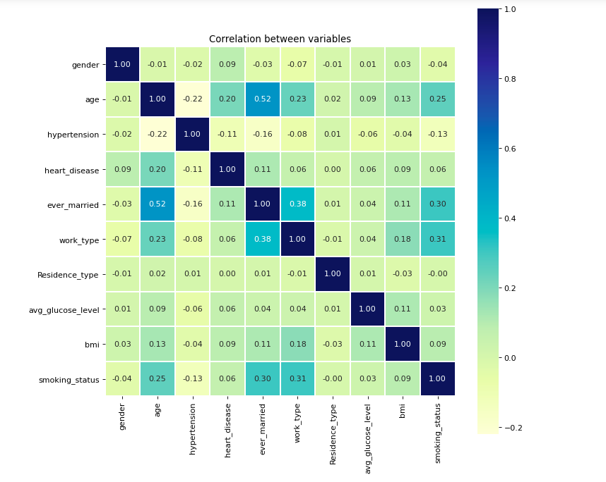
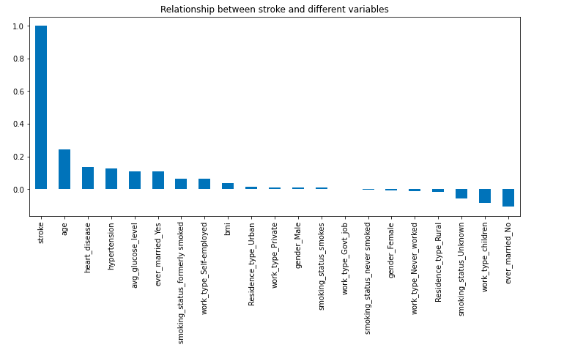
Data Analysis Process b. Exploratory Data Analysis
6
Correlation Matrix One-hot relationship
Figure 5 : Correlation Matrix Figure 6 : One-hot relationship

Slide 7
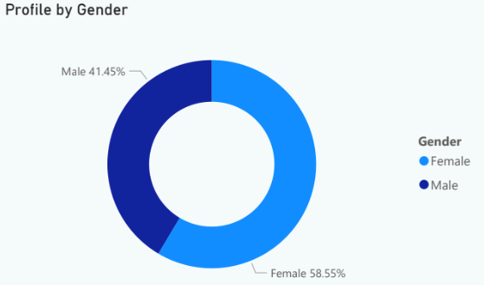
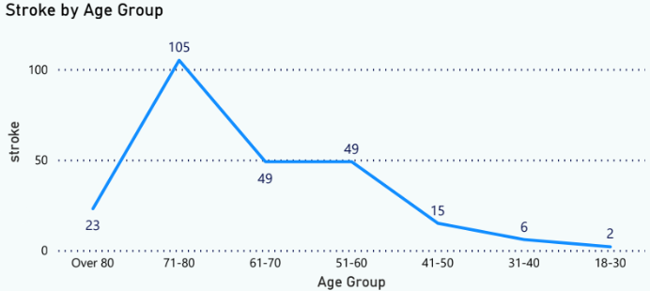
Data Analysis Process
7
Figure 7 : Profile by Gender Figure 8 : Stroke by Age Group

Slide 8
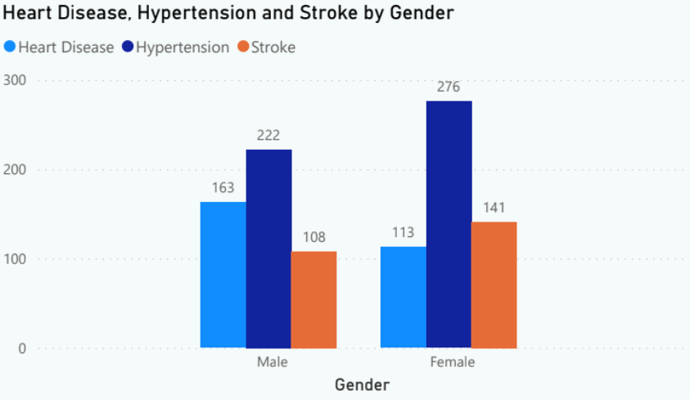
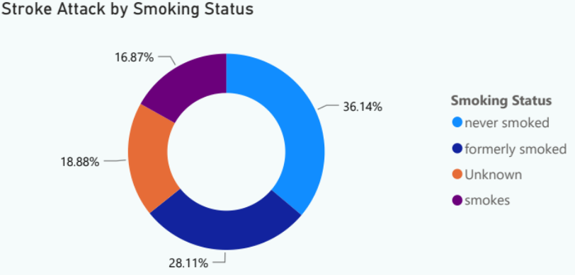
Data Analysis Process
8
Figure 9 : Heart Disease, Hypertension and Stroke by Gender Figure 10 : Stroke Attack by Smoking Status

Slide 9
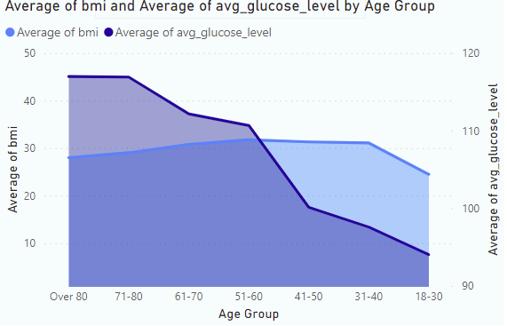
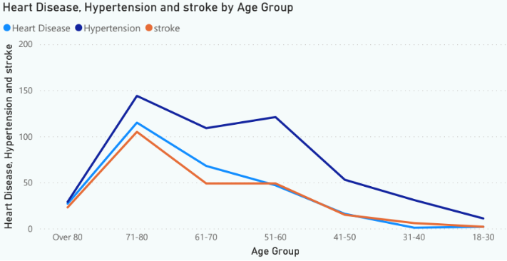
Data Analysis Process
Figure 11 : Avg of bmi and Avg Glucose level by Age Group Figure 12 : Heart Disease, Hypertension and Stroke by Age Group
9

Slide 10
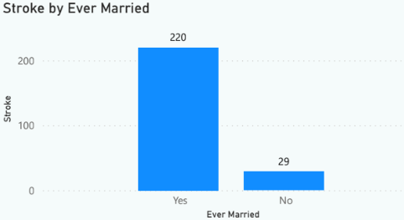
Data Analysis Process
Figure 13 : Stroke by Ever Married
10

Slide 11
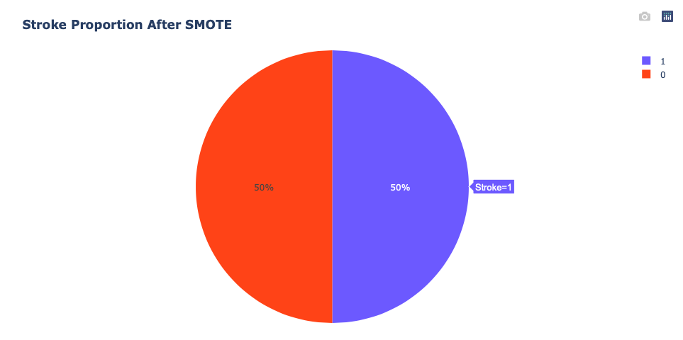
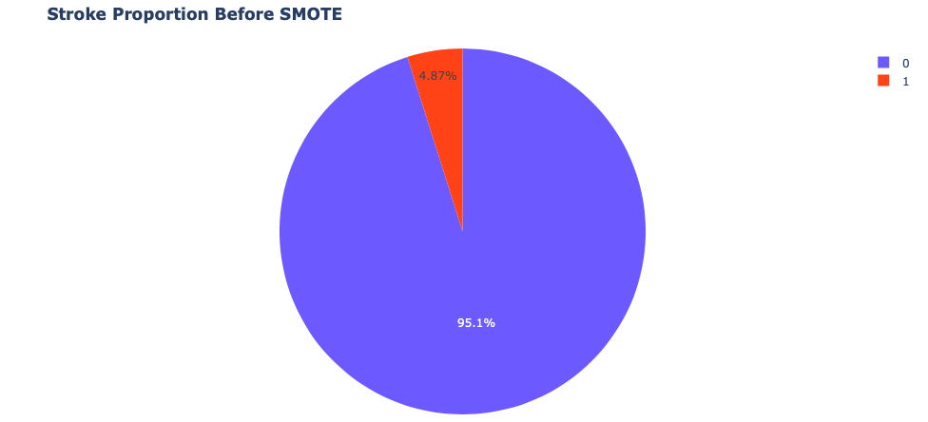
Data Analysis Process c. Handling Unbalanced Data (SMOTE)
Synthetic Minority Oversampling Technique
Figure 14 : Stroke Proportion Before SMOTE Figure 15 : Stroke Proportion After SMOTE
11

Slide 12
Data Analysis Process c. Modeling
12
Comparison of different methods
 | Decision Tree | Random Forest | Support Vector Machine | Logistic Regression | KNN | Naïve Bayes
Recall | 0.41 | 0.47 | 0.82 | 0.85 | 0.55 | 0.88
Precision | 0.79 | 0.81 | 0.73 | 0.77 | 0.74 | 0.73
F1 Score | 0.54 | 0.59 | 0.78 | 0.81 | 0.63 | 0.80
Accuracy | 0.65 | 0.68 | 0.76 | 0.80 | 0.68 | 0.77

Slide 13
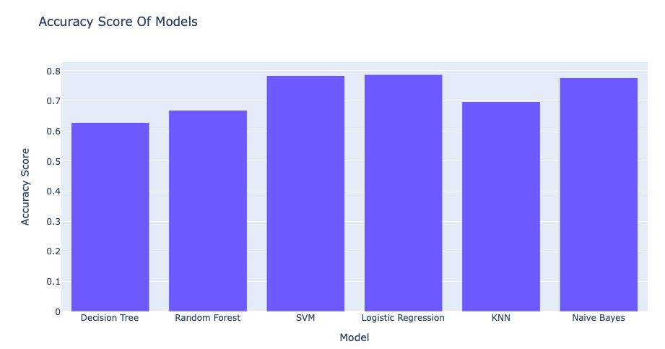
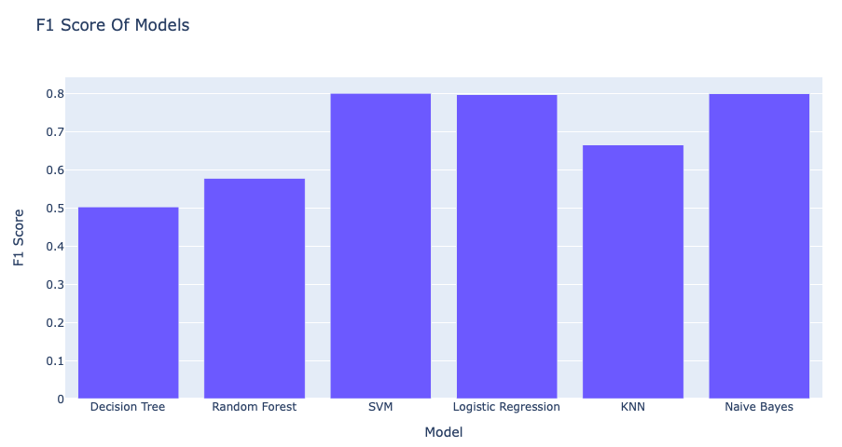
Data Analysis Process
Figure 16 : Accuracy for Different Models Figure 17 : F1 Score for Different Models
13

Slide 14
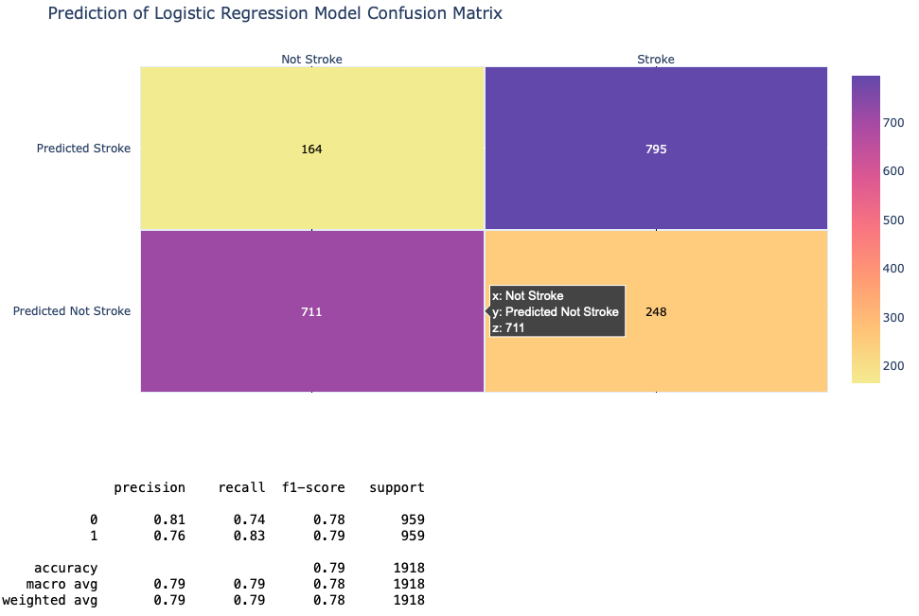
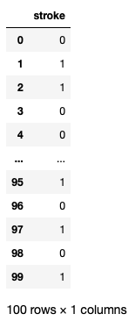
Data Analysis Process
Chose Logistic Regression as our predicting model
Figure 18 : Logistic Regression Confusion Matrix Figure 19 : Predicted Result for Last 100 Rows
14

Slide 15
Conclusion
15
Best model: Logistic Regression
Higher risk patients:
> 40 years old
High Hypertension
High Heart Disease
Smoked users
Bias issues on dataset:
Small amount of data in dataset
Unbalanced dataset
Less various predictors

